Slide 1

Ecoantibio
Colloque One Health Antibiorésistance
Limoges, 3 avril 2019
Cécile ADAM, BISPE

Slide 2
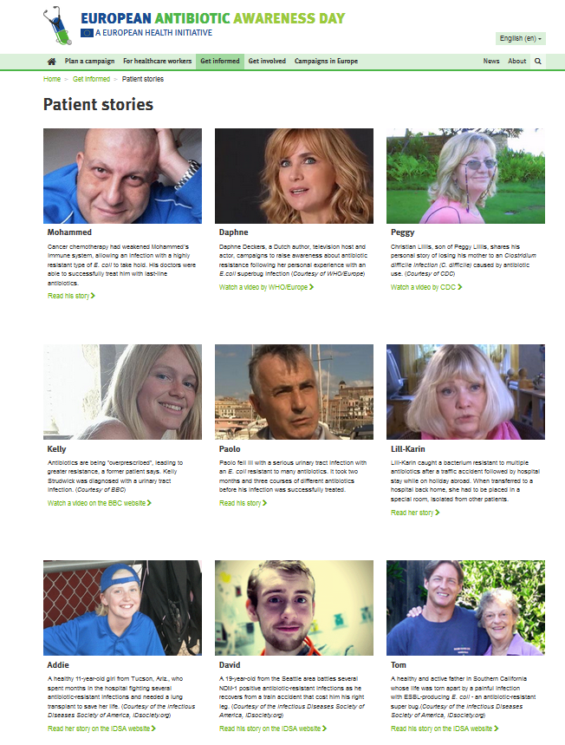
Resistance to antibiotics (ABR)
Today according to ECDC (Nov. 2018):
  More than 5,500 deaths each year in France
  33,000 deaths each year in Europe
In 2050: 1 death every 3 seconds (O’Neill report)
Every use of antibiotic can lead to ABR: bacteria from animals gut (but also from skin, breathing apparatus) and environment
Resistant bacteria travel all around the world
A single solution: drastically decrease antibiotic use
Extracted on 2019/27/02 from
https://antibiotic.ecdc.europa.eu/en/patient-stories

Slide 3

The Ecoantibio plan fights against ABR in the animal sector
2 successive action plans built on the same basis:
  Ecoantibio 1 (2012 – 2016)
    Mandatory regulatory measures
    Targeted ambitious objectives:
      Reduce animal exposure to antibiotics by 25% in 5 years,
      Reduce animal exposure to critically important antibiotics by 25% in 3 years (objectives set in the Law for the future of agriculture, food and forest)

Slide 4
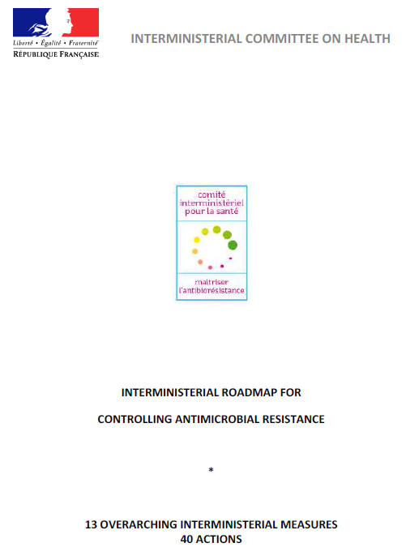

The Ecoantibio plan fights against ABR in the animal sector
2 successive action plans :
  Ecoantibio 2 (2017 – 2021)
    Maintain the momentum and follow up the results
    More incentive measures
    One Health dimension: Ecoantibio is part of the interministerial roadmap for controlling antimicrobial resistance
    Targeted objectives :
      Reduce by 50% in 5 years cattle, pig and poultry exposure to colistine
      Obtain a downward trend on most of ABR indicators

Slide 5
























The Ecoantibio plan fights against ABR in the animal sector
Both plans were co-constructed and co-implemented with all the stakeholders

Slide 6

Monitoring of antibiotic use: tool for managing the plan
ECOANTIBIO 1
Monitoring of antibiotic use and ABR is essential:
  Made by the French Agency for Food, Environmental and Occupational Health & Safety (ANSES)
  Recorded antibiotic sales since 1999 enable the calculation of the ALEA (animal level of exposure to antibiotics)
  Allows to analyze how efficient were the actions
ALEA decrease for critically important antibiotics
in 2017:
87,8% fluoroquinolones vs. 2013
94,2 % C3/C4G vs. 2013
61,1% colistine vs. 2011
-38,9 % in 6 years (2012-2017)

Slide 7
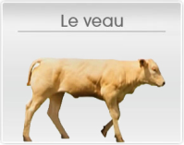
Monitoring of ABR: 2 complementary tools exist
1. Surveillance of ABR in zoonotic and commensal bacteria in pig, poultry and cattle, at slaughterhouse and retail (Decision UE 2013/652)
Monitored bacteria:
Salmonella
Campylobacter jejuni
E. Coli indicatrices
E. Coli BLSE, AmpC carbapénémases
Even-numbered years: chicken and turkey
Odd-numbered years : cattle < 1 year et pig
E. coli sensitivity /caeca
Evolution with time(2015-2017)

Slide 8

Monitoring of ABR: 2 complementary tools exist
2. The Résapath network, ANSES
Resistance to fluoroquinolones in E. coli, different species, in 2017

Slide 9
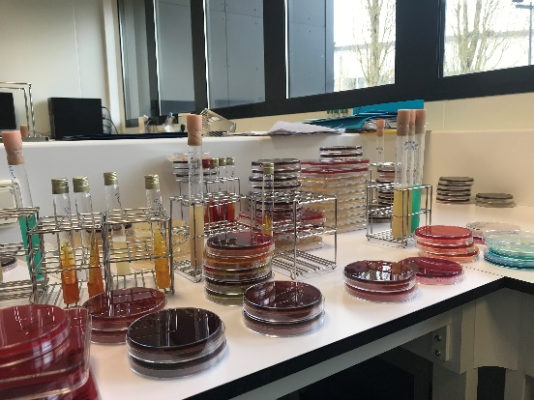

Mandatory measures: examples
Restrict the use of critically important antibiotics
Objective : avoid the use of critically important antibiotics (CIA) (which should be used only to treat human diseases) whenever other medicine or antibiotics can be used successfully
Legal tools:
  Preventive use of CIA is forbidden
  Curative and metaphylactic use possible only after:
    Clinical examination or necropsy
    Sampling and identifying the bacteria
    Sensitivity testing
2) Ban on discounts for antibiotics sales

Slide 10
Mandatory measures : mandatory hygiene education visits devoted to ABR
Cattle: 2016
  10 million euros spent by the State
  152 996 cattle farmers were visited
  6% of the questionnaires (8 914) were randomly selected for analysis:
    Raising awareness in cattle farmer population was necessary
    There is still room for improvement
    Report available online: https://agriculture.gouv.fr/visites-sanitaires-obligatoires-en-elevage (FR)
Pigs: 2018-2019

Slide 11








Incentive measures: communication campaigns

Slide 12
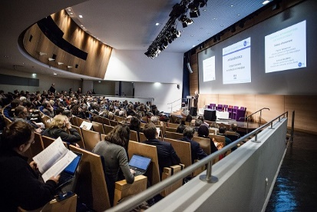
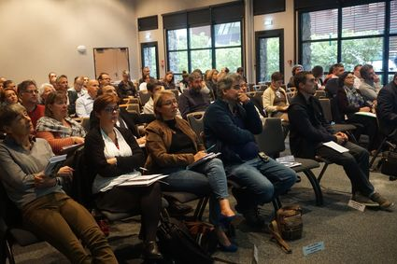
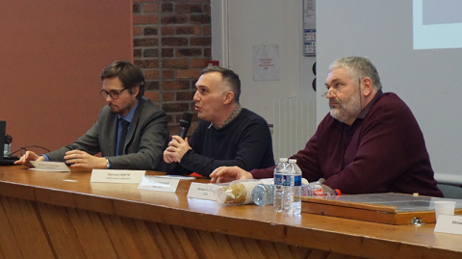
Incentive measures : One health meetings
Interministerial meeting 2018
Yearly interministerial meeting
Regional meetings
Meeting in region Auvergne Rhône Alpes 2018
Meeting in region Pays de la Loire 2018

Slide 13








Incentive measures : network of veterinarians expert in antibiotherapy
Positive evaluation of pilot phase 2014-2018
Network being extended to all the mainland regions of France
Financed thanks to Ecoantibio budget
4 experts
Specialized in pets, cattle, horses
4 « super » experts
Specialized in AMR, pharmacology, microbiology

Slide 14
Incentive measures : research
Ecoantibio call for projects published every year on the Ministry website
2 millions €/year ➔ 190 projects have been financed or cofinanced since 2013 thanks to Ecoantibio call for projects
Ecoantibio call for projects covers the different actions and measures defined in the plan
Funding for 2 kinds of project:
  Research projects
  Action projects

Slide 15
Incentive measures : research
Examples of research/action projects on prevention
Vaccination:
  Analysis of sociological and economical determinants for the early vaccination of weanlings against breathing disorders
Zootechnics:
  Audit of biosecurity in pigs in order to decrease antibiotic use
  Create and broadcast messages on the links between the farm buildings and animal health for lambs

Slide 16
Incentive measures : research
Examples of projects focusing on resistance
Laboratory technics:
  DIAMIC : obtaining and comparing data of minimal inhibitory concentration and antibiograms for animal pathogenic bacteria
Resistance mechanisms:
  PLASMEQUI : dissemination and persistence of cephalosporin resistance plasmids in horses: impact of feed additives

Slide 17
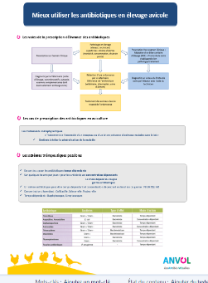
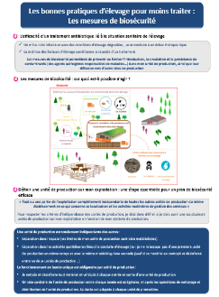
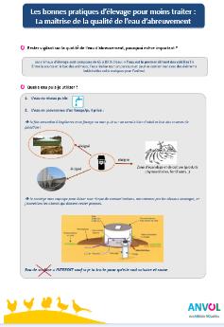
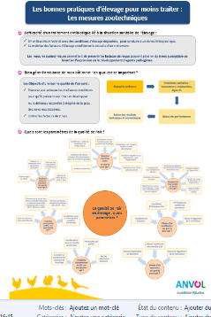

Incentive measures : research
Examples of projects on training
Farmers training:
  Designing of 5 teaching materials for different species of poultry
Veterinarians training:
  Designing of a training course for pets veterinarians
Teaching kids and teenagers (in schools, comprehensive schools and highschools) : e Bug

Slide 18
Incentive measures : focus on alternatives to antibiotics (plants, essential oils, phages…)
Context:
  Need for scientific data on their efficacy, safety and non-contribution to AMR;
  Need for a regulatory frame, in accordance with European regulation
Action led by competent authority:
  Expertise by ANSES, February 2018
  French Agency for Veterinary Medicinal Products (ANMV) : lighten marketing authorization file, tax divided by 3
  DGAL: research for solutions at the European level, Ecoantibio call for projects
  DGER: inter-school diploma on phytotherapy
  Surveillance of training programs from different organizations, and therapeutic claims
Examples of research projects financed by Ecoantibio call for projects:
  Alter for fish (A2F) : Efficacy and safety of alternatives to antibiotics for farmed fish
  Evaluation of the efficacy of essential oils on limb disorders in rabbits in order to decrease AMU

Slide 19
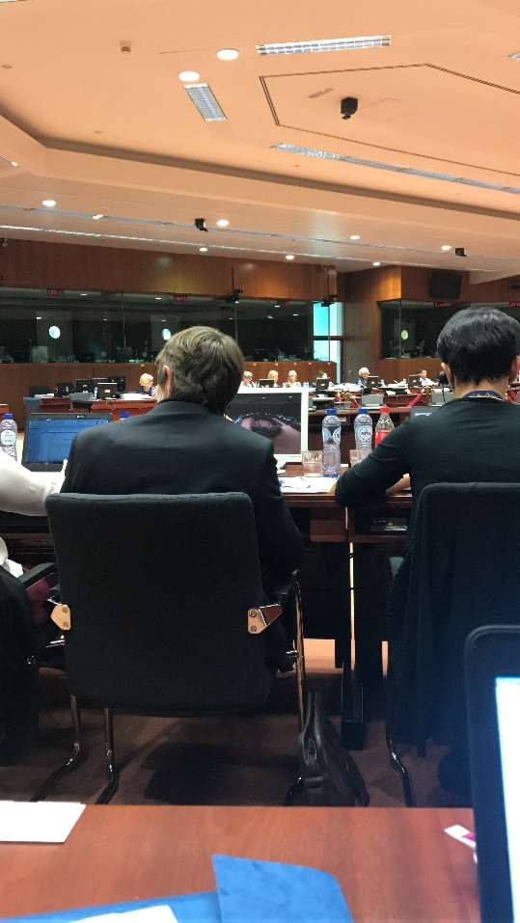
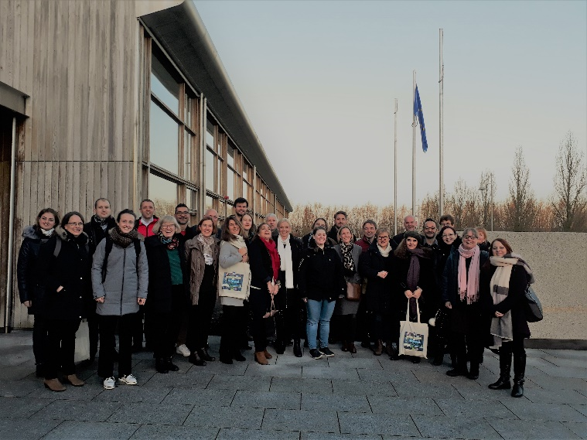
Ministry actions : communication at the European level
Communication of French positions: during negotiations of the regulations regarding veterinary medicines and medicated feed
  The new regulations (R. 2019/4 and 6) reinforce the fight against AMR
Communication on Ecoantibio during the One Health AMR network meeting or during BTSF

Slide 20
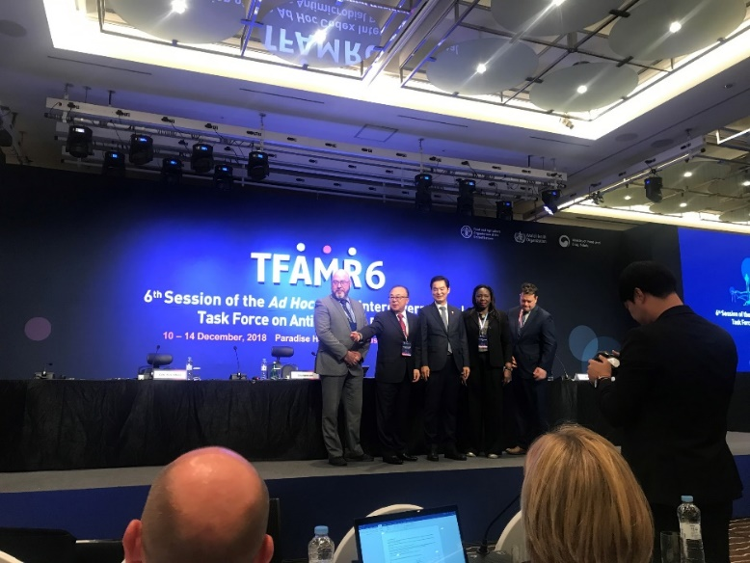
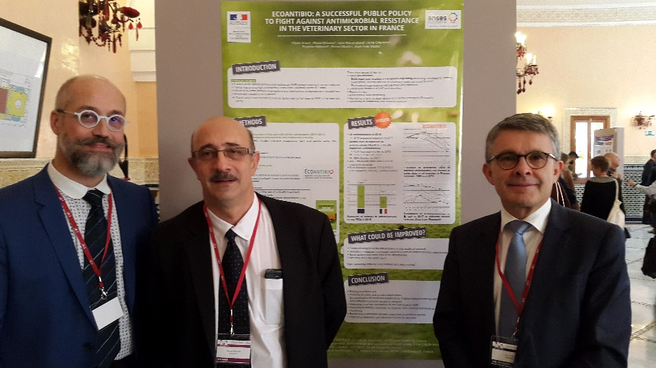
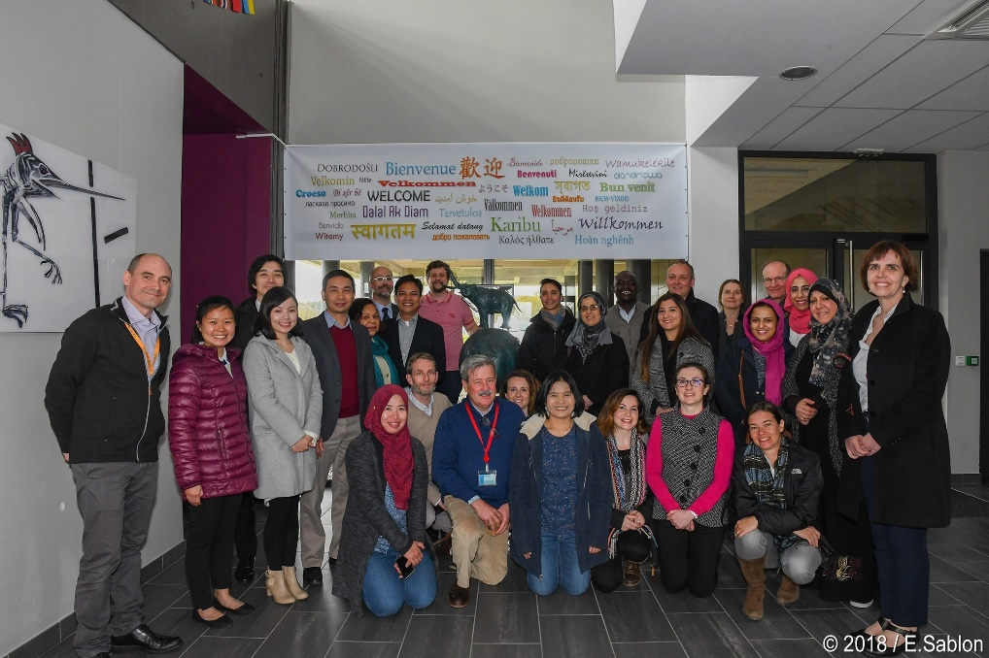
Ministry actions : communication at the international level
French positions on AMR are expressed in G20 (health and agriculture groups), G7, Codex, OIE, FAO, training of third-country official veterinarians, etc.
Spring course ENSV, March 2018.
French delegation in front of the Ecoantibio poster, OIR world conference on AMR, Marrakech, 29-31 Oct. 2019
Task Force AMR Codex in Busan, South Korea, Dec. 2018

Slide 21
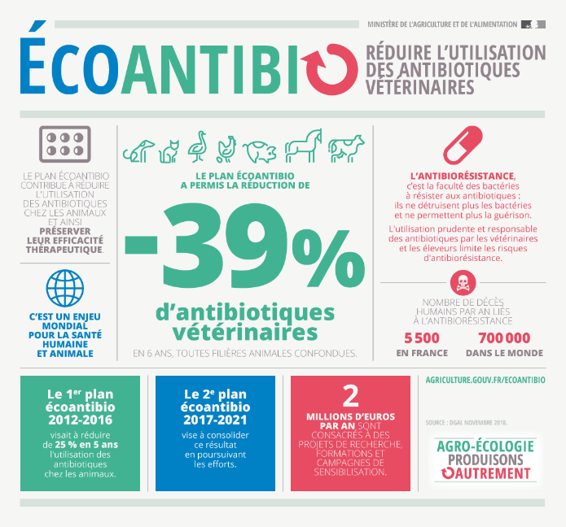

Conclusion
The first Ecoantibio national action plan was a success thanks to all the stakeholders‘ commitment, particularly the couple veterinarian - farmer
Very high number of diverse actions were conducted
Ecoantibio 2 has to make changes in practice durable in order to reduce misuse of antibiotics

